Slide 1

QUALITY ASSURANCE DASHBOARD

Slide 2

ABSTRACT
ABSTRACT
The Quality Assurance Dashboard is designed to monitor and improve software quality using Java and MongoDB. It tracks key metrics like defects, performance, and testing progress. The dashboard provides real time insights that help teams make data driven decisions and maintain high product standards.

Slide 3

INTRODUCTION
Intro
The quality assurance dashboard is a tool that helps monitor and manage the quality of software products. It collects and displays data related to testing, defects, and performance in a visual format. Using Java for backend logic and MongoDB for data storage, the dashboard provides an easy way to track progress and identify issues. This project aims to make the quality assurance process faster, more organized, and data driven.

Slide 4

MODULE DESCRIPTION
Login Module:
Allows users or team members to securely log in to the dashboard using authentication credentials
Data Collection Module:
Collects quality-related data such as defects, test cases, and performance metrics and stores them in the MongoDB
Data Processing Module:
Uses Java logic to process, filter, and analyze the collected data to generate useful insights.
Report Generation Module:
Generates detailed reports about product quality, test results, and overall performance for management review.

Slide 5
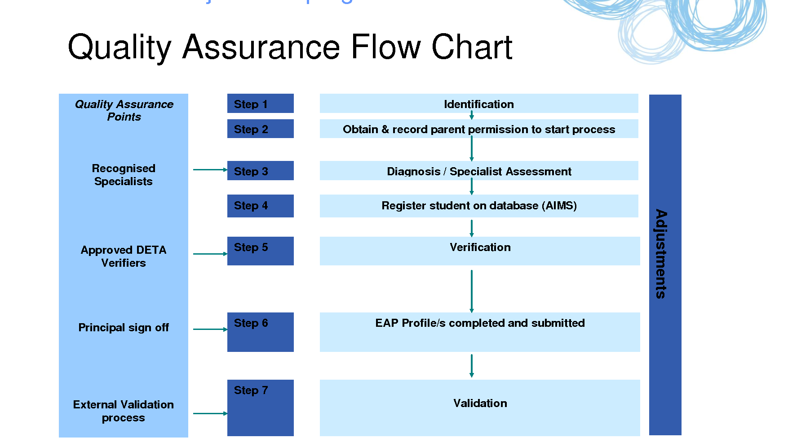
PRODUCT OVERVIEW
TESTED

Slide 6

OUTPUT FORMAT
QUALITY ASSURANCE DASHBOARD
Module Name : Login Module
Total Testcases : 50
Passed : 47
Failed : 03
Defect Rate : 6%
Overall Quality Status : GOOD

Slide 7

ADVANTAGES
Real Time Monitoring:
Tracks quality metrics and testing progress instantly.
Data Driven Decisions:
Helps teams make better decisions based on accurate analytics.
Better Visualization:
Presents information in easy to understand charts and graphs.
Enhanced Quality Control:
Ensures consistent standards throughout the software development process.

Slide 8

DISADVANTAGES
Initial Setup Complexity:
Setting up the dashboard and database connection requires technical knowledge.
Data Dependency:
The accuracy of the dashboard depends on the quality of the data entered
Limited Offline Access:
The dashboard may not function properly without an internet or database connection.
High Resource Usage:
Processing large amounts of data can increase memory and CPU usage.

Slide 9

CONCLUSION The Quality Assurance Dashboard helps in monitoring, analyzing, and improving software quality efficiently. It provides real time insights through visual reports and metrics, making it easier to identify defects and track testing progress. Using Java and MongoDB, the system ensures reliable data processing and storage. Overall, this project improves decision making, saves time, and supports maintaining high quality software standards.
REFERENCES
Oracle Java–https://docs.oracle.com/javase/
MongoDB Official– https://www.mongodb.com/docs/
GeeksforGeeks – Tutorials on Java and MongoDB Research Papers and Articles on Software Quality Assurance and Dashboard Systems

